Slide 1




What Is the Most Efficient Way to Select Nearest Neighbor Candidates for Fast Approximate Nearest Neighbor Search?
Masakazu Iwamura, Tomokazu Sato and Koichi Kise
(Osaka Prefecture University, Japan)
ICCV’2013
Sydney,
Australia

Slide 2



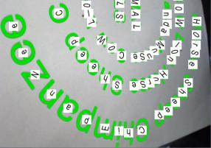
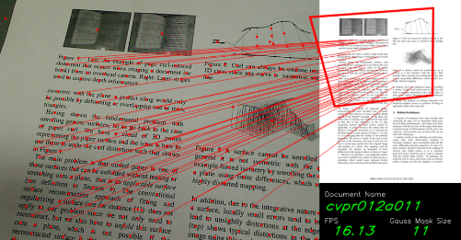
Finding similar data
Basic but important problem in information processing
Possible applications include
  Near-duplicate detection
  Object recognition
  Document image retrieval
  Character recognition
  Face recognition
  Gait recognition
A typical solution: Nearest Neighbor (NN) Search

Slide 3
Finding similar data by NN Search
Desired properties
  Fast and accurate
  Applicable to large-scale data
Benefit from improvement of computing power
The paper presents a way to realize
faster approximate nearest neighbor search for certain accuracy

Slide 4
Contents
NN and Approximate NN Search
Performance comparison
Keys to improve performance

Slide 5
Contents
NN and Approximate NN Search
Performance comparison
Keys to improve performance

Slide 6
Nearest Neighbor (NN) Search
This is a problem that the true NN is always found
In a naïve way
Data
Query
NN
For more data,
more time is required

Slide 7
Nearest Neighbor (NN) Search
Finding nearest neighbor efficiently
Before query is given
NN
Index data
After query is given
Search regions
Select search regions
Calculate distances of selected data
The true NN must be contained in the selected search regions
Ensuring this takes so long time

Slide 8
Approximate Nearest Neighbor Search
Finding nearest neighbor more efficiently
“Approximate” means that the true NN is not guaranteed to be retrieved
NN
Search regions
Much faster

Slide 9
Performance of approximate nearest neighbor search
☺ Shorter comp. time
Computational
time
Short
Long
☹ Lower accuracy
Accuracy
Low
High
Stronger approximation
There is a trade-off relationship!

Slide 10
Contents
NN and Approximate NN Search
Performance comparison
Keys to improve performance

Slide 11
ANN search on 100M SIFT features
GOOD
BAD
Selected results

Slide 12
ANN search on 100M SIFT features
GOOD
IVFADC
(Jegou 2011)
IMI
(Babenko 2012)
BAD
Selected results

Slide 13
ANN search on 100M SIFT features
GOOD
2.0 times
BDH
(Proposed method)
4.5 times
9.4 times
2.9 times
IVFADC
(Jegou 2011)
IMI
(Babenko 2012)
BAD
Selected results

Slide 14
ANN search on 100M SIFT features
GOOD
2.0 times
BDH
(Proposed method)
4.5 times
9.4 times
2.9 times
IVFADC
(Jegou 2011)
IMI
(Babenko 2012)
The novelty of BDH was reduced by IMI before we succeeded in publishing it…
(For more detail, check out the Wakate program on Aug. 1)
BAD
Selected results

Slide 15
ANN search on 100M SIFT features
GOOD
2.0 times
BDH
(Proposed method)
4.5 times
9.4 times
2.9 times
IVFADC
(Jegou 2011)
IMI
(Babenko 2012)
So-called binary coding is not suitable for fast retrieval but for saving memory usage
BAD
Selected results

Slide 16
Contents
NN and Approximate NN Search
Performance comparison
Keys to improve performance

Slide 17
Keys to improve performance
Select search regions in subspaces
Find the closest ones in the original space efficiently

Slide 18
Keys to improve performance
Select search regions in subspaces
Find the closest ones in the original space efficiently

Slide 19
Select search regions in subspaces
In past methods (IVFADC, Jegou 2011 &
VQ-index, Tuncel 2002)
Search regions
Indexed by k-means clustering
Query

Slide 20
Select search regions in subspaces
In past methods (IVFADC, Jegou 2011 &
VQ-index, Tuncel 2002)
Search regions
Indexed by k-means clustering
Indexed by vector quantization
Pros.
Proven to be the least quantization error
Query
Cons.
Taking very much time to select the search regions

Slide 21
Select search regions in subspaces
In the past state-of-the-art (IMI, Babenko 2012)
Indexed by k-means clustering
Calculate distances
in subspaces
Divide into two or more
Feature vectors
Indexed by k-means clustering
Select the regions in the original space

Slide 22
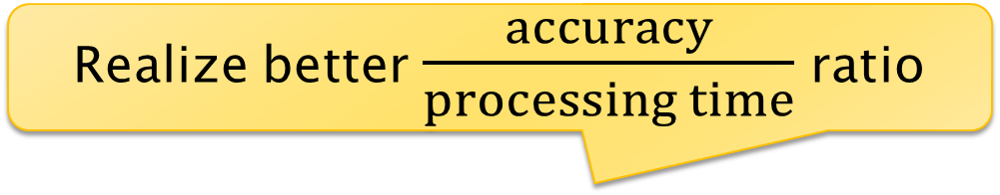
Select search regions in subspaces
In the past state-of-the-art (IMI, Babenko 2012)
Realize better $\frac{accuracy}{processing time}$ ratio
Calculate distances
in subspaces
Indexed by product quantization
Divide into two or more
Pros.
Much less processing time
>
Feature vectors
Cons.
Less accurate
(More quantization error)
Select the regions in the original space

Slide 23
Keys to improve performance
Select search regions in subspaces
Find the closest ones in the original space efficiently

Slide 24
Find the closest search regions in original space
In the past state-of-the-art (IMI, Babenko 2012)
Centroid in original space
Search regions are selected in the ascending order of distances in the original space
11
Subspace 1
11
12
5
5
6
8
2
Distances in subspace 1
2
3
5
10
1
1
2
4
9
16
15
1
3
8
15
Centroid in subspace
8
1
3
Distances in subspace 2
Subspace 2

Slide 25
Find the closest search regions in original space
In the past state-of-the-art (IMI, Babenko 2012)
Centroid in original space
Search regions are selected in the ascending order of distances in the original space
11
This can be done more efficiently with the branch and bound method
Subspace 1
11
12
5
5
6
8
2
Distances in subspace 1
2
3
5
10
1
It does not consider the order of selecting buckets
1
2
4
9
16
15
1
3
8
15
Centroid in subspace
8
1
3
Distances in subspace 2
Subspace 2

Slide 26
Find the closest search regions in original space efficiently
In the proposed method
Assume that upper limit is set to 9
Centroid in original space
11
1
1
2
3
Subspace 1
5
0
2
5
8
1
11
15
15
Centroid in subspace
8
1
3
Distances in subspace 1
Distances in subspace 2
Subspace 2

Slide 27
Find the closest search regions in original space efficiently
In the proposed method
Assume that upper limit is set to 9
Centroid in original space
Max 9
11
1
1
2
3
Subspace 1
5
0
2
5
8
1
11
15
15
Centroid in subspace
8
1
3
Distances in subspace 1
Distances in subspace 2
Subspace 2

Slide 28
Find the closest search regions in original space efficiently
In the proposed method
Assume that upper limit is set to 9
Centroid in original space
Max 9
Max 9
11
1
1
2
3
Subspace 1
5
0
1
2
5
8
1
11
15
15
Centroid in subspace
8
1
3
Distances in subspace 1
Distances in subspace 2
Subspace 2

Slide 29
Find the closest search regions in original space efficiently
In the proposed method
Assume that upper limit is set to 9
Centroid in original space
Max 9
Max 9
11
1
1
2
3
Subspace 1
5
0
2
2
5
8
1
11
15
15
Centroid in subspace
8
1
3
Distances in subspace 1
Distances in subspace 2
Subspace 2

Slide 30
Find the closest search regions in original space efficiently
In the proposed method
Assume that upper limit is set to 9
Centroid in original space
Max 9
Max 9
11
1
1
2
3
Subspace 1
5
0
5
2
5
8
1
11
15
15
Centroid in subspace
8
1
3
Distances in subspace 1
Distances in subspace 2
Subspace 2

Slide 31
Find the closest search regions in original space efficiently
In the proposed method
  The upper and lower bounds are increased in a step-by-step manner until enough number of data are selected

Slide 32
What Is the Most Efficient Way to Select Nearest Neighbor Candidates for Fast Approximate Nearest Neighbor Search?
Masakazu Iwamura, Tomokazu Sato and Koichi Kise
(Osaka Prefecture University, Japan)
ICCV’2013
Sydney,
Australia

